Slide 1
G3 model: A practical Lean approach to Improve Technology Delivery in Banks
Philippe Guenet
July 2016

Slide 2
“Morning”... nice to meet you all!
Exec Delivery Manager @ GFT
GFT – Business & Technology Consultancy in Financial Services
Onshore Business & IT Consultancy
Onshore / Nearshore Project Delivery
Boutique @ scale
Pioneering with Agile delivery in Banks many years ago
And needless to say with a number of teething issues…

Slide 3
Trigger to Change – Project challenges
Details have to remain anonymous
Pre-committed deadline, budget, objectives
(10min) estimate was 24,000 md of Development
2 months planning / de-scoping later c.17,000 md (greenfield)
Evolution c. 9,500 md (evolution)
SAFe as methodology (loosely)
Scope shaven at planning, regrown in elaboration or as defects at the tune of +40/50% per release train
Delivered near on-time and budget
Multiple re-planning occurred throughout
Successfully heroic yet utterly inefficient Delivery
Team burnout
Quality inevitably suffered
Project is continuing into on-going releases + refactoring
Throughput same with team half the size thanks to DevOps, reduction in cycle time, rebalancing of flow, harder prioritisation
Same teams, new stakeholder…
Was this a Delivery success?
Or an Agile experience gone wrong?

Slide 4

As a service provider, we are often blamed for the outcome, yet we are generally powerless to fix it!!

Slide 5
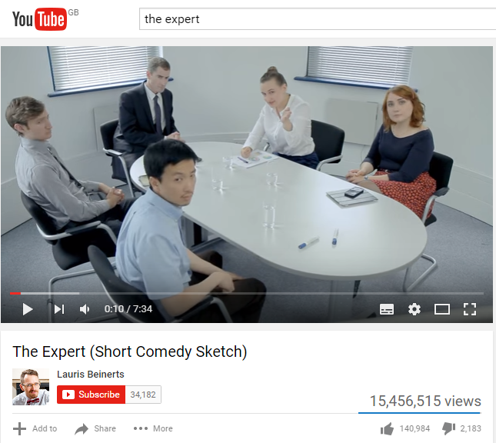
But our very existence is linked to being the ‘Expert’

Slide 6

Patterns of the challenges
Product Owner was not sufficiently engaged
Management had no Agile culture
Legacy processes leading to legacy technology
c30% waste
c20% waste
c20% waste
Much UX visualisation
Rework of unelaborated requirements
Wait time for answers
Over-engineering and unnecessary fancy requirements
15% of team diverted to planning
Generally the most senior and onshore resources
Tooling inadequate
Much branching
Never time to automate tasks
Whole team slowed by build / release process

Slide 7
Waste is generally cumulative
Efficiency baseline : 70% x 80% x 80% = 45%
> 50% of the effort would have been wasted

Slide 8

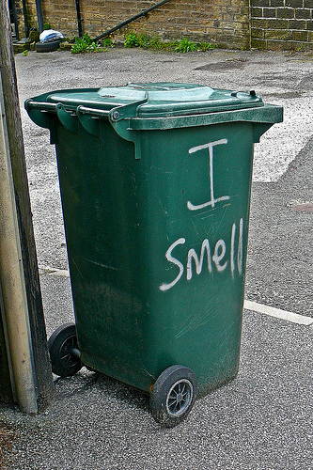
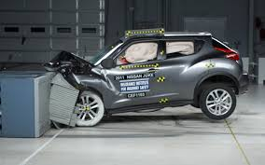
As a professional service organisation we find solutions
Duty to our people
Duty to our reputation
Duty to our Clients
Heroic Delivery = Team burnout
Poor quality
= Technical Debt
Project Crash = Business consequences

Slide 9
Theory of Constraints applied to solutions

Slide 10
The Product Owner Problem
Req.
Elab.
Dev.
Test.
Live
Waste
Solutions
Measure
Data driven Agile dashboards
Data points to influence (e.g. focus factor)
Balance the flow
Augment Product Owner capacity
Or reduce downstream capacity and accept deadline impact
Shorten, not extend cycle time
Releasing the output focuses the input
Get DevOps right up front to avoid downstream constraint
Actual throughput
Waste
Symptoms and consequences
Functionality over quality
PO too senior to make the stand-up
BAs / Proxy PO overruled
Elaboration consuming capacity
IT PM losing hair over plan
Scope out-of-control
High levels of defects
Poor code quality
Much overtime from Dev & Ops teams

Slide 11
Excessive planning / WaterScrum
Req.
Elab.
Dev.
Test.
Live
Solutions
Measure
Measure the cost of planning
Drive governing to the constraints rather than planning to them
Educate / Mentor
Lean / Agile way is logical but often counter-intuitive
Look at efficiency end-to-end towards the goal
Govern in flight
Take H/L baseline estimate
Define targets and manage to them
Waste
Actual throughput
Symptoms and consequences
Teams diverted to estimation
Scope yoyo
Mini-waterfall cycles
“UAT” sprints
Heavy onshore management cost
Disgruntled team
“getting what you are given”

Slide 12
Dealing with Legacy
Req.
Elab.
Dev.
Test.
Live
Waste
Solutions
Measure quality
Measure quality (DoD, record Tech Debt, Sonar)
Evolve Architectures
MVP first, polish after
Greenfield overhauls are wasteful
Drive discipline to care about the product
Refactor as standard
Measure and reduce Debt Servicing cost (production support, adhoc fixes, incidents, Legacy code)
Measure Tech Debt trend
Actual throughput
Symptoms and consequences
DoD – what?
No coding standards
Not tracking quality to them
Spaghetti code
Team diverted to Prod Support
Architects diverted to Prod Support

Slide 13
How do we establish a framework where we industrialise such solutions?

Slide 14


How do we ignite Stars from Nebulae?
Continuous Transformation programme
State of Agility
Waste reduction
Measurements
Lean
Change

Slide 15
Rationalise the organisation with a purpose (G3 model)
Business Change Projects
Lean/Agile
UX/UI
Specialist Units
Data
DevOps
Technology Transformation
Regulatory Compliance
Risk
Operations
Trade
Finance
Compliance
Vertical Delivery Units across a Bank
Feature teams
Supporting Business units
Multiple Apps / Projects
Use critical mass to optimise
Specialist teams
Embedded with Delivery teams
Drive re-use & tech transformation

Slide 16
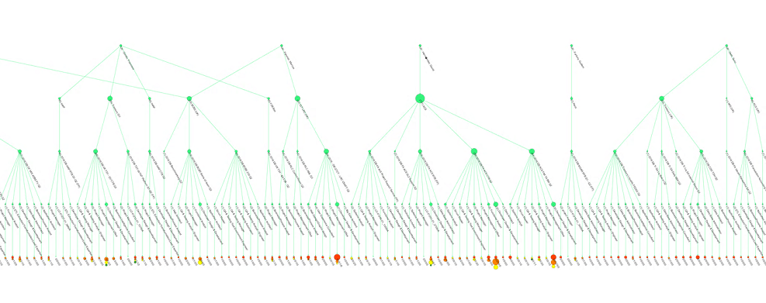
Rationalise the organisation with a purpose
Example of mapping a Delivery portfolio and shaping the vertical delivery units

Slide 17
Measure waste and systematically reduce through Continuous Improvements
GENERAL
WASTE
On-boarding
Tools
Team balance
Re-use
Co-location
PROCESS WASTE
Requirements
Analysis /
Elaboration
Development
Testing
Release / Ops
Motion
Transport
Wait
Motion
Transport
Wait
Motion
Transport
Wait
Motion
Transport
Wait
AVOIDABLE REWORK
Defects
Incidents
Clarifications / Changes
Change
Unnecessary functionality
Manual tasks
TECHNICAL DEBT
Arch Debt
Tech Debt
Lack of test coverage
DevOps tax
Debt servicing

Slide 18
Work in Progress
Early teething issues
Bandwidth to be self-critical
Disconnect across organisation
Lean culture in IT
Sourcing
Integrating vertical and horizontal units
Delivery Units breaks established alignments
Who owns the Horizontal Specialisms?
Nobody wants to highlight waste
Management does like the Gemba
Driving transformation from data
Influence right decisions from right data
Factual Agile dashboards
Waste identification and management
Technical Debt measurement
Scaling into the Banks
Start with self
Commercial models & incentives
Scale to the Enterprise, take lessons from the Automotive world

Slide 19
And still experimenting…
I will not pretend that we found the holy grail, this is just a direction of travel
It is providing more elements to persuade in complex enterprises to transform them to a state of agility
Please keep in touch and share your experiences if you are on the same journey

Slide 20
Thank you
Philippe Guenet
Executive Delivery Manager – GFT
philippe.guenet@gft.com
@WeAreLeanIT

